Slide 1

HOW DO INTELLIGENT ASSISTANTS UNDERSTAND AND ANSWER QUESTIONS?
Unit 2, Module 2.3
Notes:
Day 3 - How do intelligent assistants understand and answer questions?
(Query) Syntax and Question Answering
Google queries; Berkeley parser; mention schemas
Question Answering
Representation for the questions - Berkeley Neural Parser
Parts of speech: nouns, verbs, prepositions
Syntactic relationships
How BNP works - Not a purely syntactic parser it uses meaning of words and statistics
Semantic parsing
Sources of knowledge
Limitation: Systems are a collection of techniques
Question: How does Google understand and answer questions?
Demo -
Try asking Google these questions:
*What do wolves eat?
*Where do wolves live?
*What sounds do wolves make?
*How long do wolves live?
*Do wolves have families?
*Where did President Obama grow up?
*What are the biggest cities in Georgia?
*What are the smallest towns in Georgia?
Conversion: Convert feets to yard?
Flights:
Facts: Presidents
Q. Let’s explore how Google might make sense of these queries:
Use The Berkeley Neural Parser to parse sentences and observe the parse tree.
Uses the parse to figure out the primary intent / type of query of your question
Google knows about a bunch of different types of queries (uses specialized reasoning engines - use different techniques to understand the query, if they don’t understand than they do keyword search)
Here are some query engines
Definition
Current Information modules (Time, weather, temperatures, movie schedules, bus schedules, train schedules, flights)
Conversions (units, currencies, distance, time)
Restaurant reservations
Flights
Facts - Knowledge graph queries
Note: some of these modules have a way of failing -> perhaps there is a typo
Google has thousands of engineers trying to salvaging it.
Knowledge boxes, knowledge panels or similar queries
Otherwise a generic keyword search
Student Activities
Sentence -> formula -> module computes
Convert 5 feets to ? meters
Ask a non-sensical questions - COnvert 5 feet to years - suggests a corrections for years to yards and then when you force it then it sends generic information
Show a schema related to one of the project
Explore Schemas (Part of the deeper dive)
Schema.org - restaurants
Deeper Dive
What is everything google knows about restaurants? Look at the schema at schema.org
What is a restaurant? Different conceptual understandings - a business, location, chain vs individual store, brand, -Take away
When you design a knowledge graph you have to decide how much complexity you want to include. Humans make decisions about what is important to encode and for what purpose.
Identify areas of ambiguity in human speech that makes it complex
Explain how computers/AI overcome the ambiguities in human speech

Slide 2

Overview of Topics
Question Answering
Representation for the questions - Berkeley Neural Parser
Parts of speech: nouns, verbs, prepositions
Syntactic relationships
How BNP works - Not a purely syntactic parser it uses meaning of words and statistics
Semantic parsing
Sources of knowledge
Limitation: Systems are a collection of techniques

Slide 3


How do you think Google understands and
answers questions?
Discussion

Slide 4

Google Query Scavenger Hunt
https://developers.google.com/search/docs/basics/how-search-works
Units conversion
Ask Google: “Convert 5 Dollars to Euros” or “Convert 5 Miles to Kilometers”
Pick your own conversion problem: ____________________
What does Google return?_____________
Facts about famous people or places
Where was famous person born?
Pick your own fact: ____________________
What does Google return?_____________
Look up restaurant hours
Look up weather
Look up airline flights, bus, or train schedules
Word definitions: define “craven”
Movie times
Link to student assignment
Notes:
To Do: Convert this to a worksheet
Goal: We want to create queries
Draft of student activity

Slide 5

Let’s explore how Google might make sense of these queries.
Notes:
Google knows about a bunch of different types of queries (uses specialized reasoning engines - use different techniques to understand the query, if they don’t understand than they do keyword search)
Here are some query engines
Definition
Current Information modules (Time, weather, temperatures, movie schedules, bus schedules, train schedules, flights)
Conversions (units, currencies, distance, time)
Restaurant reservations
Flights
Facts - Knowledge graph queries
Note: some of these modules have a way of failing -> perhaps there is a typo
Google has thousands of engineers trying to salvaging it.
Knowledge boxes, knowledge panels or similar queries
Otherwise a generic keyword search
Student Activities
Sentence -> formula -> module computes
Convert 5 feets to ? meters
Ask a non-sensical questions - COnvert 5 feet to years - suggests a corrections for years to yards and then when you force it then it sends generic information
Show a schema related to one of the project
Explore Schemas (Part of the deeper dive)
Schema.org - restaurants

Slide 6
Processing the Query:
Tokenizing - Breaking the sentence into words and punctuation
Part of speech tagging
Parsing the request to determine the meaning of the user’s question
Creating a search request that reflects the user’s intent
Notes:
Teacher Note: Let’s look at the 3rd step in this process

Slide 7
Tokenizing the Query
Ask Google: “What are the largest cities in Georgia?”
Break the sentence down into words and separate out punctuation.
What
are
the
largest
cities
in
Georgia
?
Notes:
Teacher Note: To process the query we have to parse it. The first step is to break the sentence down into words and separate out punctuation.
Vocab parse - understand it’s syntactic structure. Understand what role each word plays in the sentence.

Slide 8
Part of Speech Tagging
Assign a part of speech to each word.
WH-pronoun
Verb: present tense
Determiner
Adjective: superlative
Noun: plural
Preposition
Proper noun
Terminator
WP
VBP
DT
JJS
NNS
IN
NNP
.
What
are
the
largest
cities
in
Georgia
?
Notes:
This slide is for informational purposes
Teacher Note: Next we want to assign a part of speech to every word. This is called part of speech tagging.

Slide 9
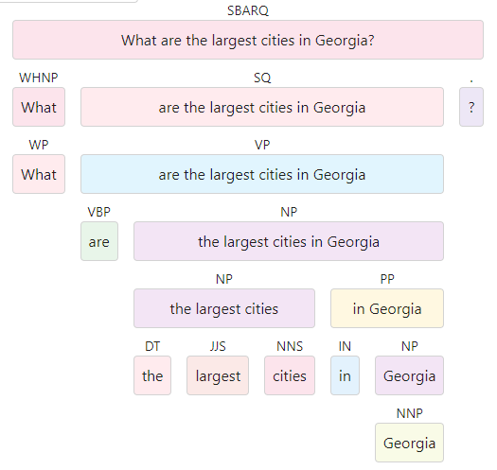
Parsing the request to determine the meaning of the user’s question
This noun phrase is what the query is about
This tells us that we have a “what”-type question.
This prepositional phrase modifies “cities” by specifying a location
This adjective modifies “cities” by specifying a size
This noun is the class of thing we’re asking about

Slide 10
Creating a database search request that reflects the user’s intent
The query generator knows that the “size” of a city most often refers to its population size. It creates the following query:
“Find cities where population size of city is large and location of city is Georgia.”
FIND x WHERE
class(x) = “city” AND
population_size(x) is large AND
location(x) = “Georgia”
SORT BY population_size
Notes:
Teacher Note:

Slide 11
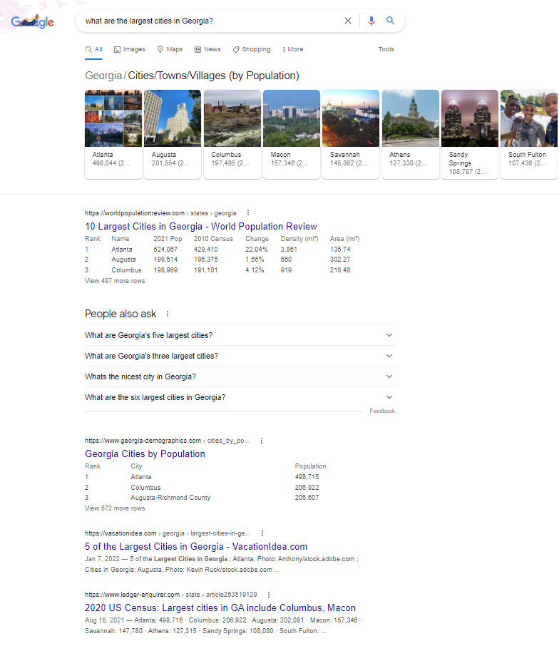
Google’s Response
What are the largest cities in Georgia?
Specialized Google Response
Image results of cities ordered by population sizes
Information captured from a website
Questions people also ask
General list of websites with relevant content based on keywords “largest cities in Georgia”
Notes:
Teacher Note: If we were to change the meaning of the query, Google will return a different set of responses.

Slide 12
Google has specialized modules for handling some common types of queries
Unit conversions (measurements, currencies, distance, time)
Weather
Airline, train, and bus schedules
Restaurant hours, locations, phone numbers, websites
Movie showtimes and locations
Biographical information about famous people
Notes:
Teacher Note:

Slide 13

Lesson Recap Activity
Complete the assignment using Google: Google Search Activity

